Slide 1

Marketing Analysis Application using Multi-Agent RAG
BY SUVRAYAN BANDYOPADHYAY

Slide 2
PROPOSED IDEA
Use a 2-phase RAG retrieval system to get data from social-media as well as company specific data
Allows model to know more about the product and hence perform better.
We will use pathway’s low-latency RAG search to retrieve relevant documents from our database.

Slide 3
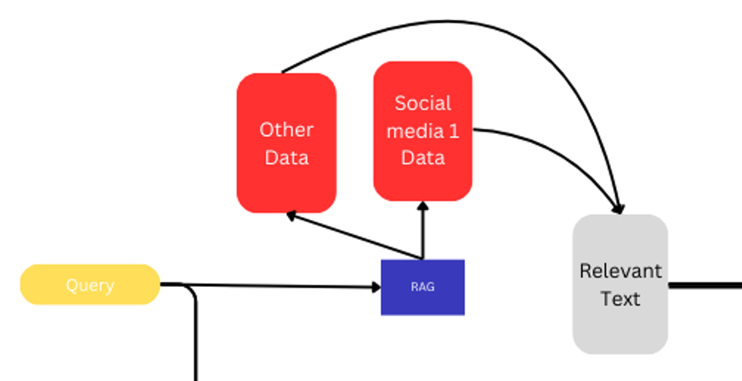

Slide 4
PROPOSED IDEA
This will give us some relevant documents which will be processed in a multi-agent sentiment analysis system. Each agent will analyze the corpus of data for different emotions. One agent will also generate a concise summary of the text.
Each agent will rate the text on a basis of 1 to 10. A higher score means that emotion is stronger in that text

Slide 5
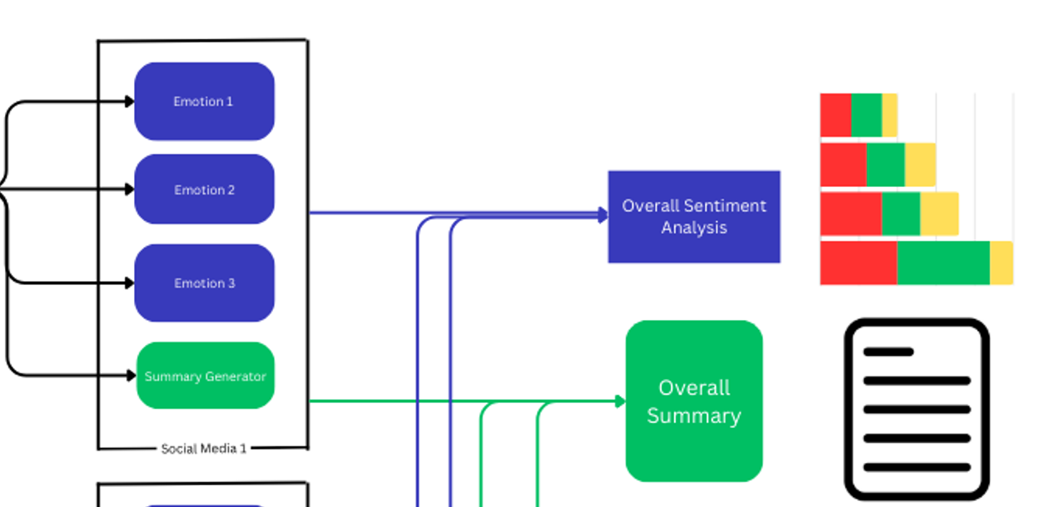
Multi Agent Analysis

Slide 6
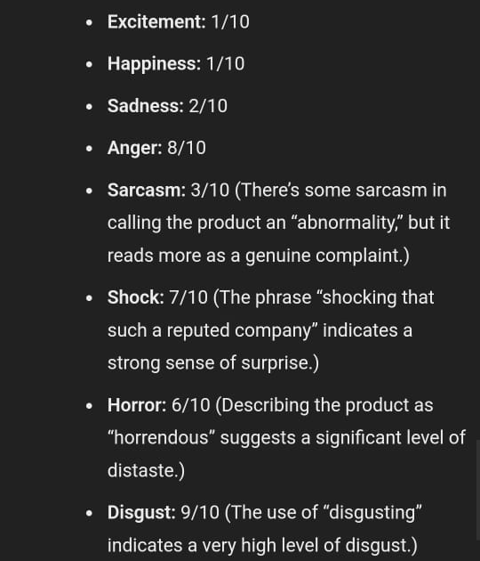
Example Result

Slide 7
Proposed Idea
For internet articles, we can get live web data using the existing python framework EXA (https://exa.ai). This API uses RAG on the internet to give us a list of relevant articles. These can be used to conduct market research on articles written about a particular product.
EXA can be easily integrated with crewAI and OpenAI platforms

Slide 8
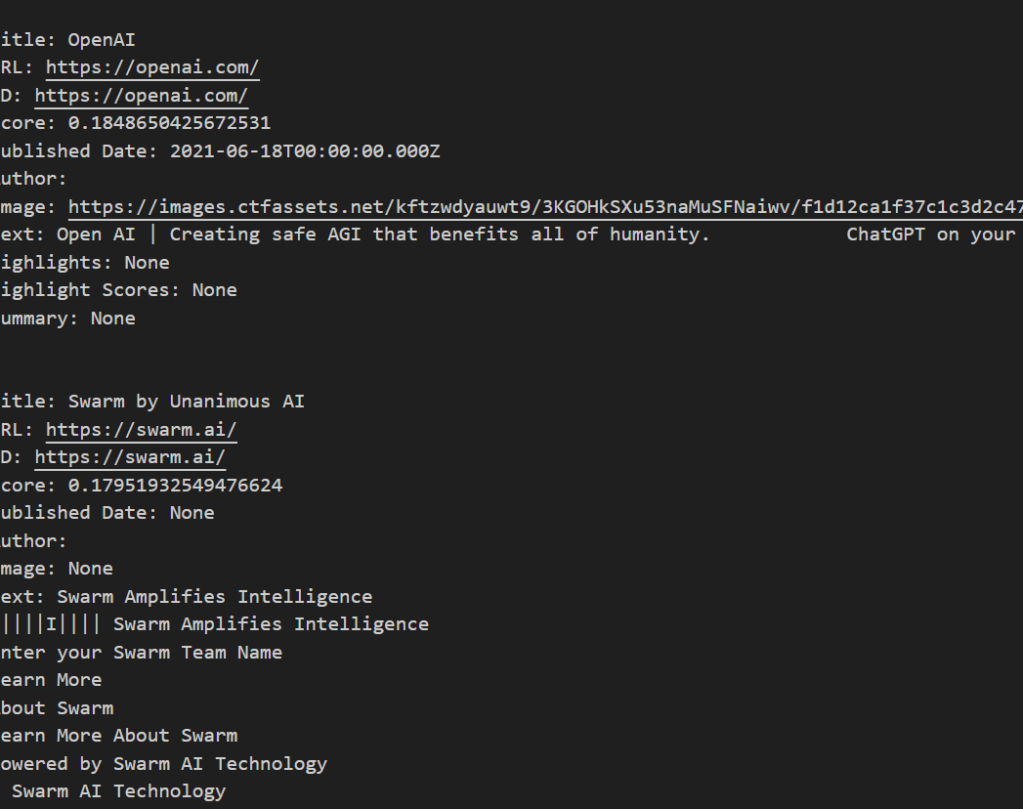
EXA AI
The result which was generated when we ask it about OpenAI swarm

Slide 9
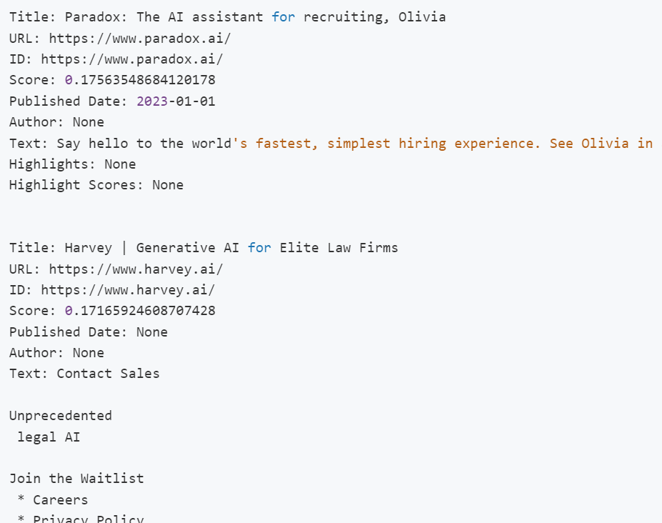
Another EXA SEARCH EXAMPLE
Based on the top AI startups

Slide 10
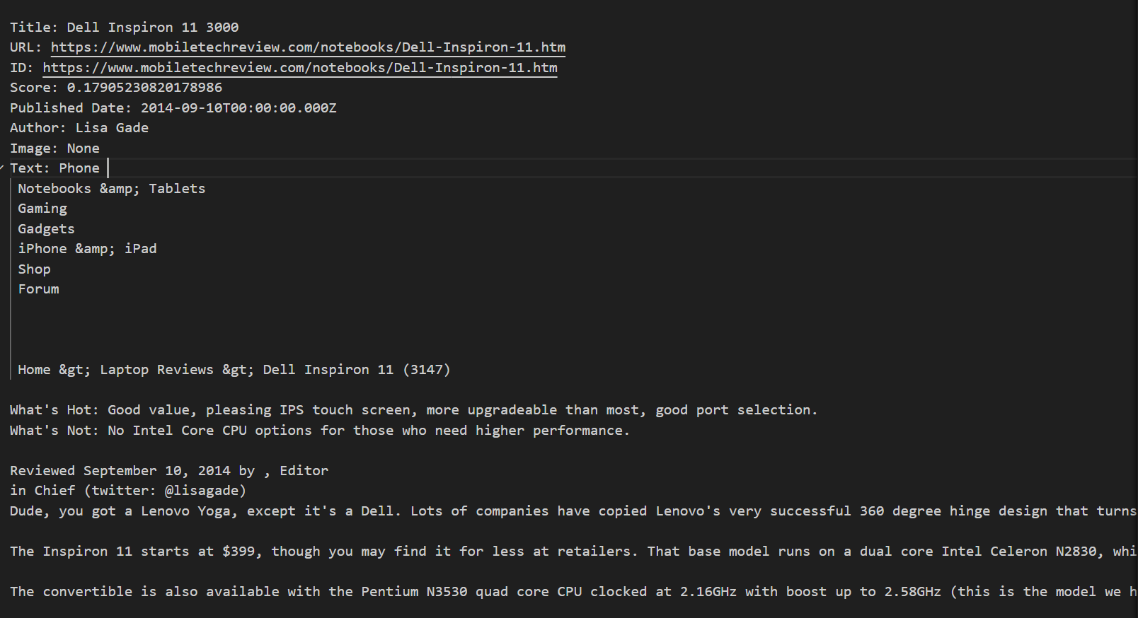
ASKING EXA TO FIND REVIEWS OF MY COMPUTER
SHOULD HAVE USED THIS BEFORE
:)

Slide 11
Integration
After our models have worked, the information is passed to a final summarizer.
This will generate the overall sentiment analysis of the product based on the rating of each comment/article.
A helpful summary will also be generated which allows the company to take decisions on improving their product.

Slide 12
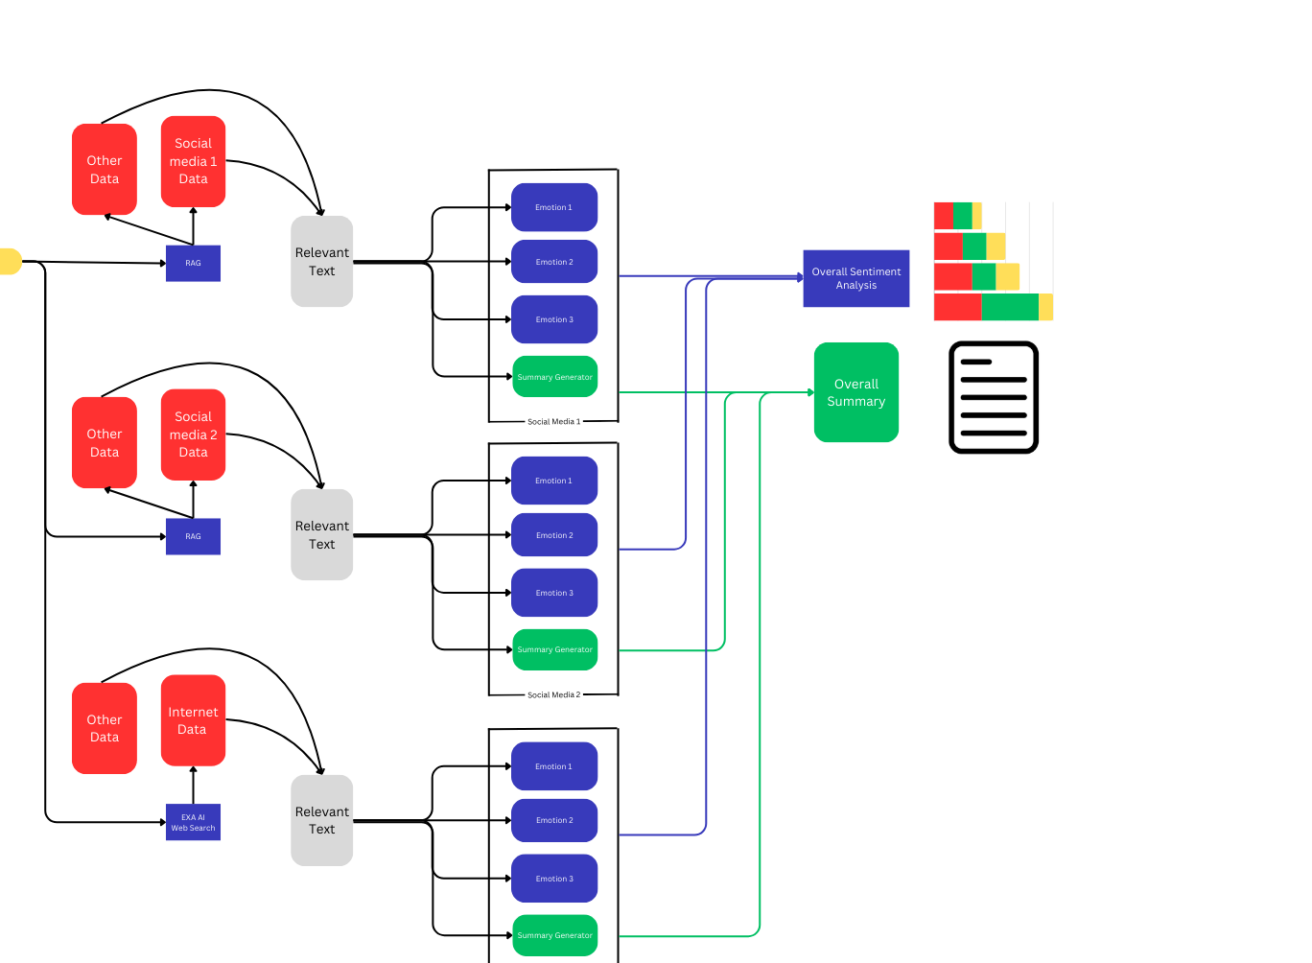
Overall Structure

Slide 13
Pathway sentiment analysis with geolocation
https://pathway.com/developers/templates/twitter

Slide 14
Thank you

